Slide 1
Danma’s Siblings:
Flys, Mills, Coffmans, and Hogues
Holt Huddle 2025 Presentation
Prepared by: Marcia Call
Photo Credits: Richard Holt, Anne Marie Coffman

Slide 2
Table of Contents
Danma’s Parents
Danma’s Siblings and Families
  Sister Annie Ethel Fly Mills
  Brother Aubrey Elmer Fly

Slide 3
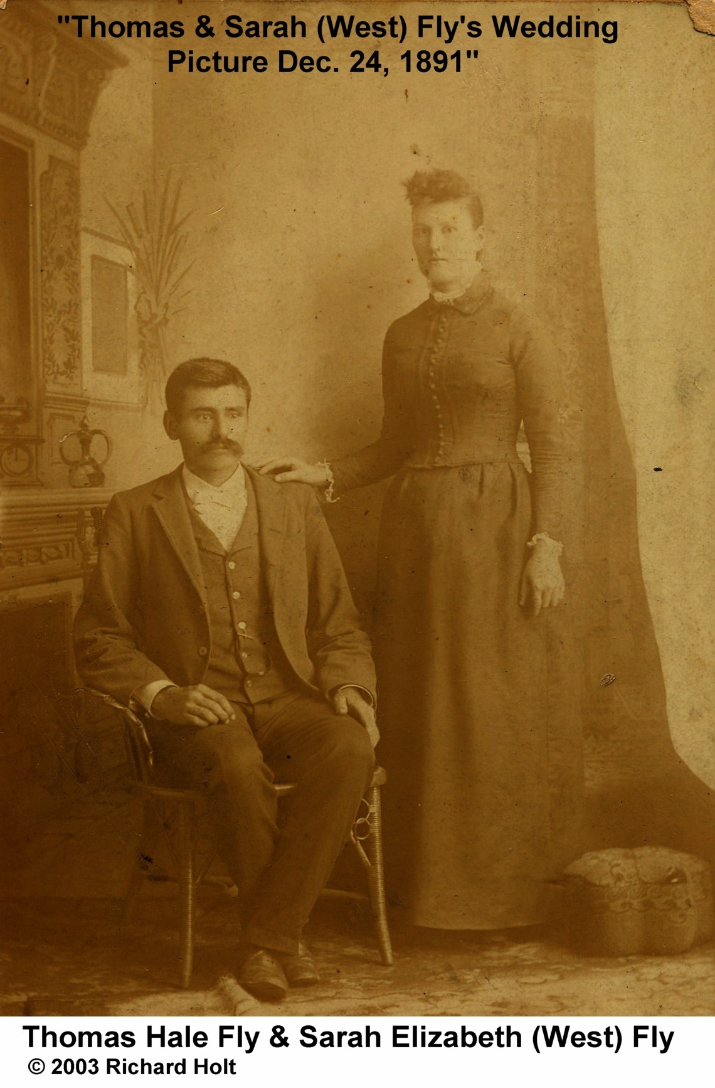
Danma’s Parents
3

Slide 4
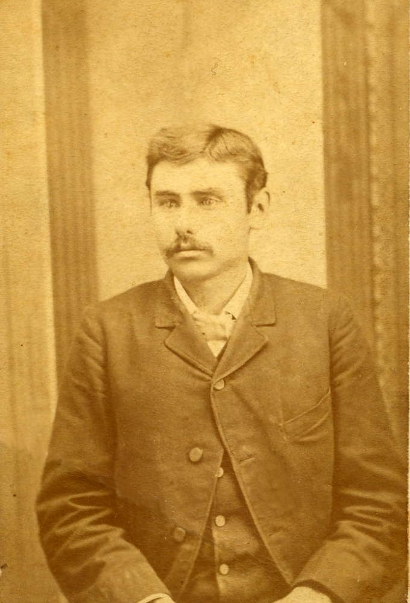
Danma’s Father: Thomas Hale Fly
Born about 7 August 1860 in Gibson County, Tennessee
Married Sara Elizabeth West on 24 December 1891 in Gibson County
1900 Census
  Farmer, can read and write and rents his home
  Wife + 3 children
1920 Census
  Farmer, working on “his own account”, owns his own home
  Household = Wife + Boarder
  Son Aubrey and Lela Mai Fly are neighbors
Died 16 July 1932 in Medina of “overheat” (heat stroke?)
Buried in Hopewell Cemetery in Medina
4

Slide 5
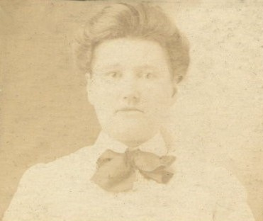
Danma’s Mother: Sara Elizabeth West*
Born 22 Dec 1869 in Gibson County, Tennessee
Married Thomas Hale Fly on 24 Dec 1891
1940 Census
  Widow, completed elementary school, owned her own house
  Living with her daughter Ethel (47) and lodger Kathleen Moore (25)
Died 23 Jan 1946 in Milan of “apoplexy”; Danma was the informant
Buried at Hopewell Cemetery in Medina
*The Wests in the Holt Family Tree are connected to the Wests in the Rich Family Tree.
5

Slide 6
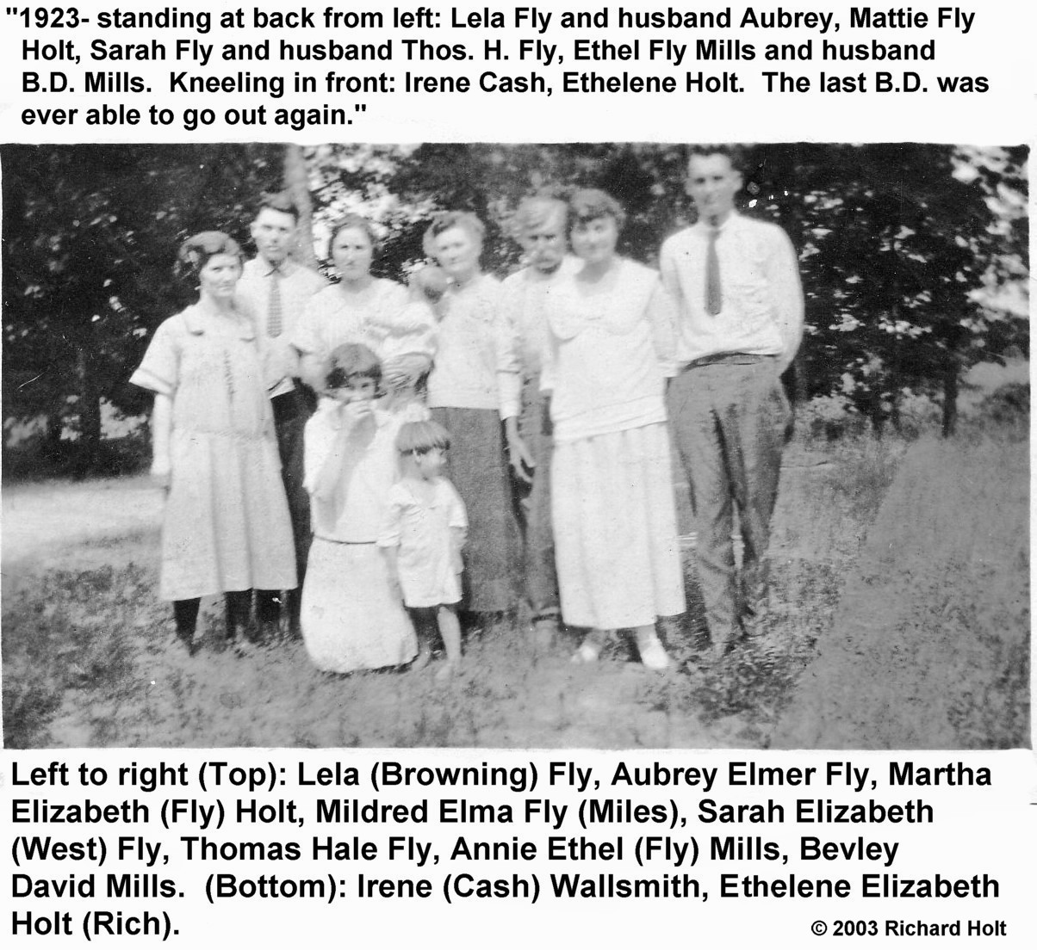
Fly Family
6

Slide 7
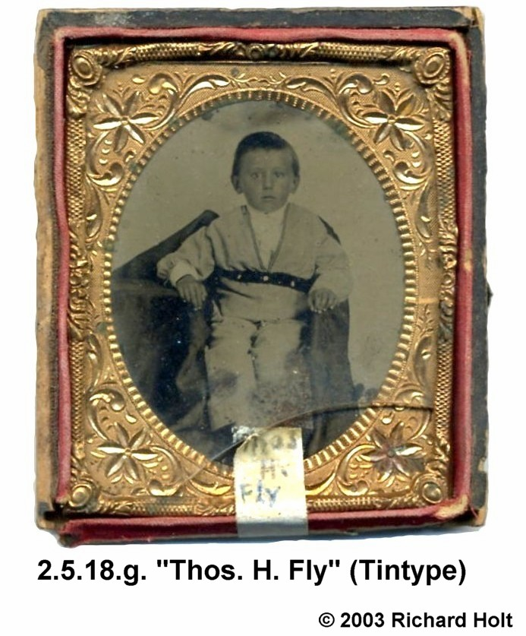
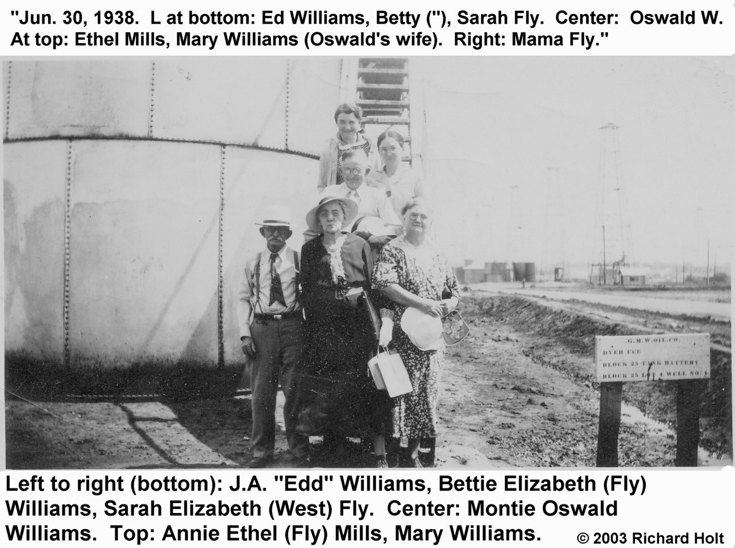
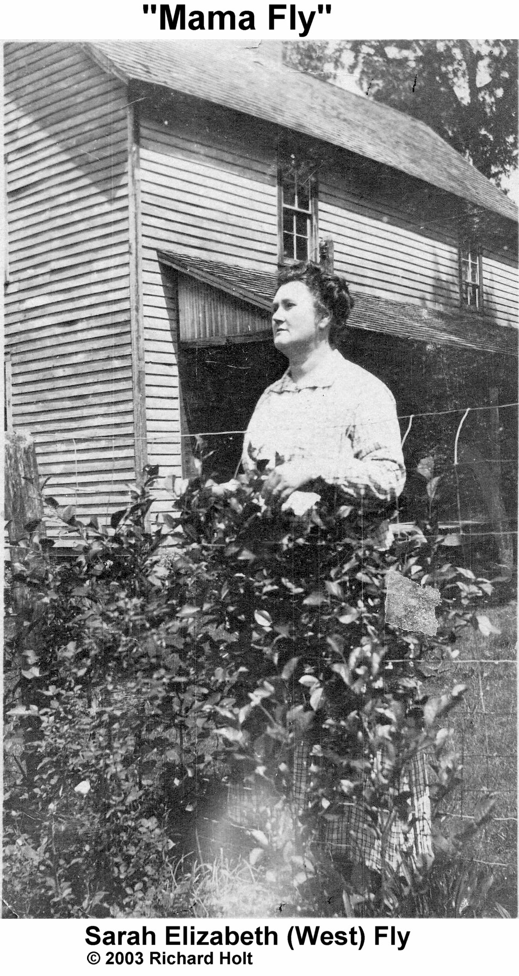
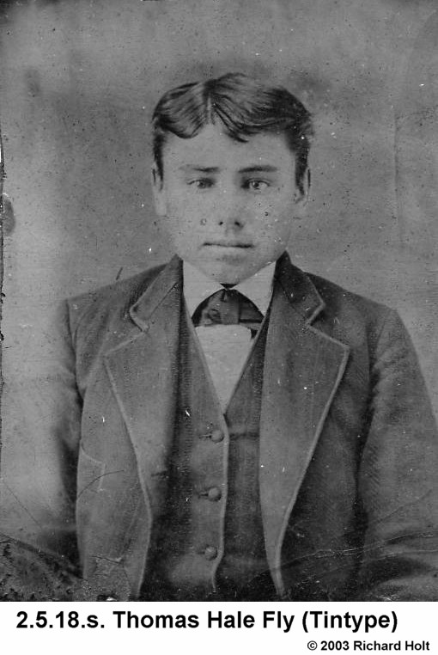
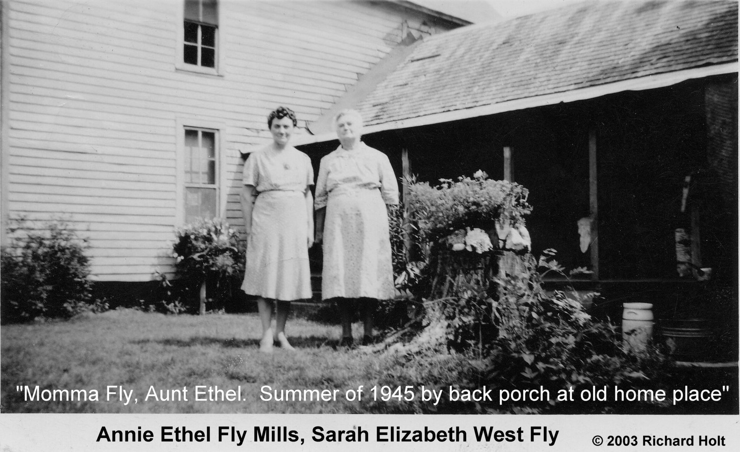
Family Photos
7

Slide 8
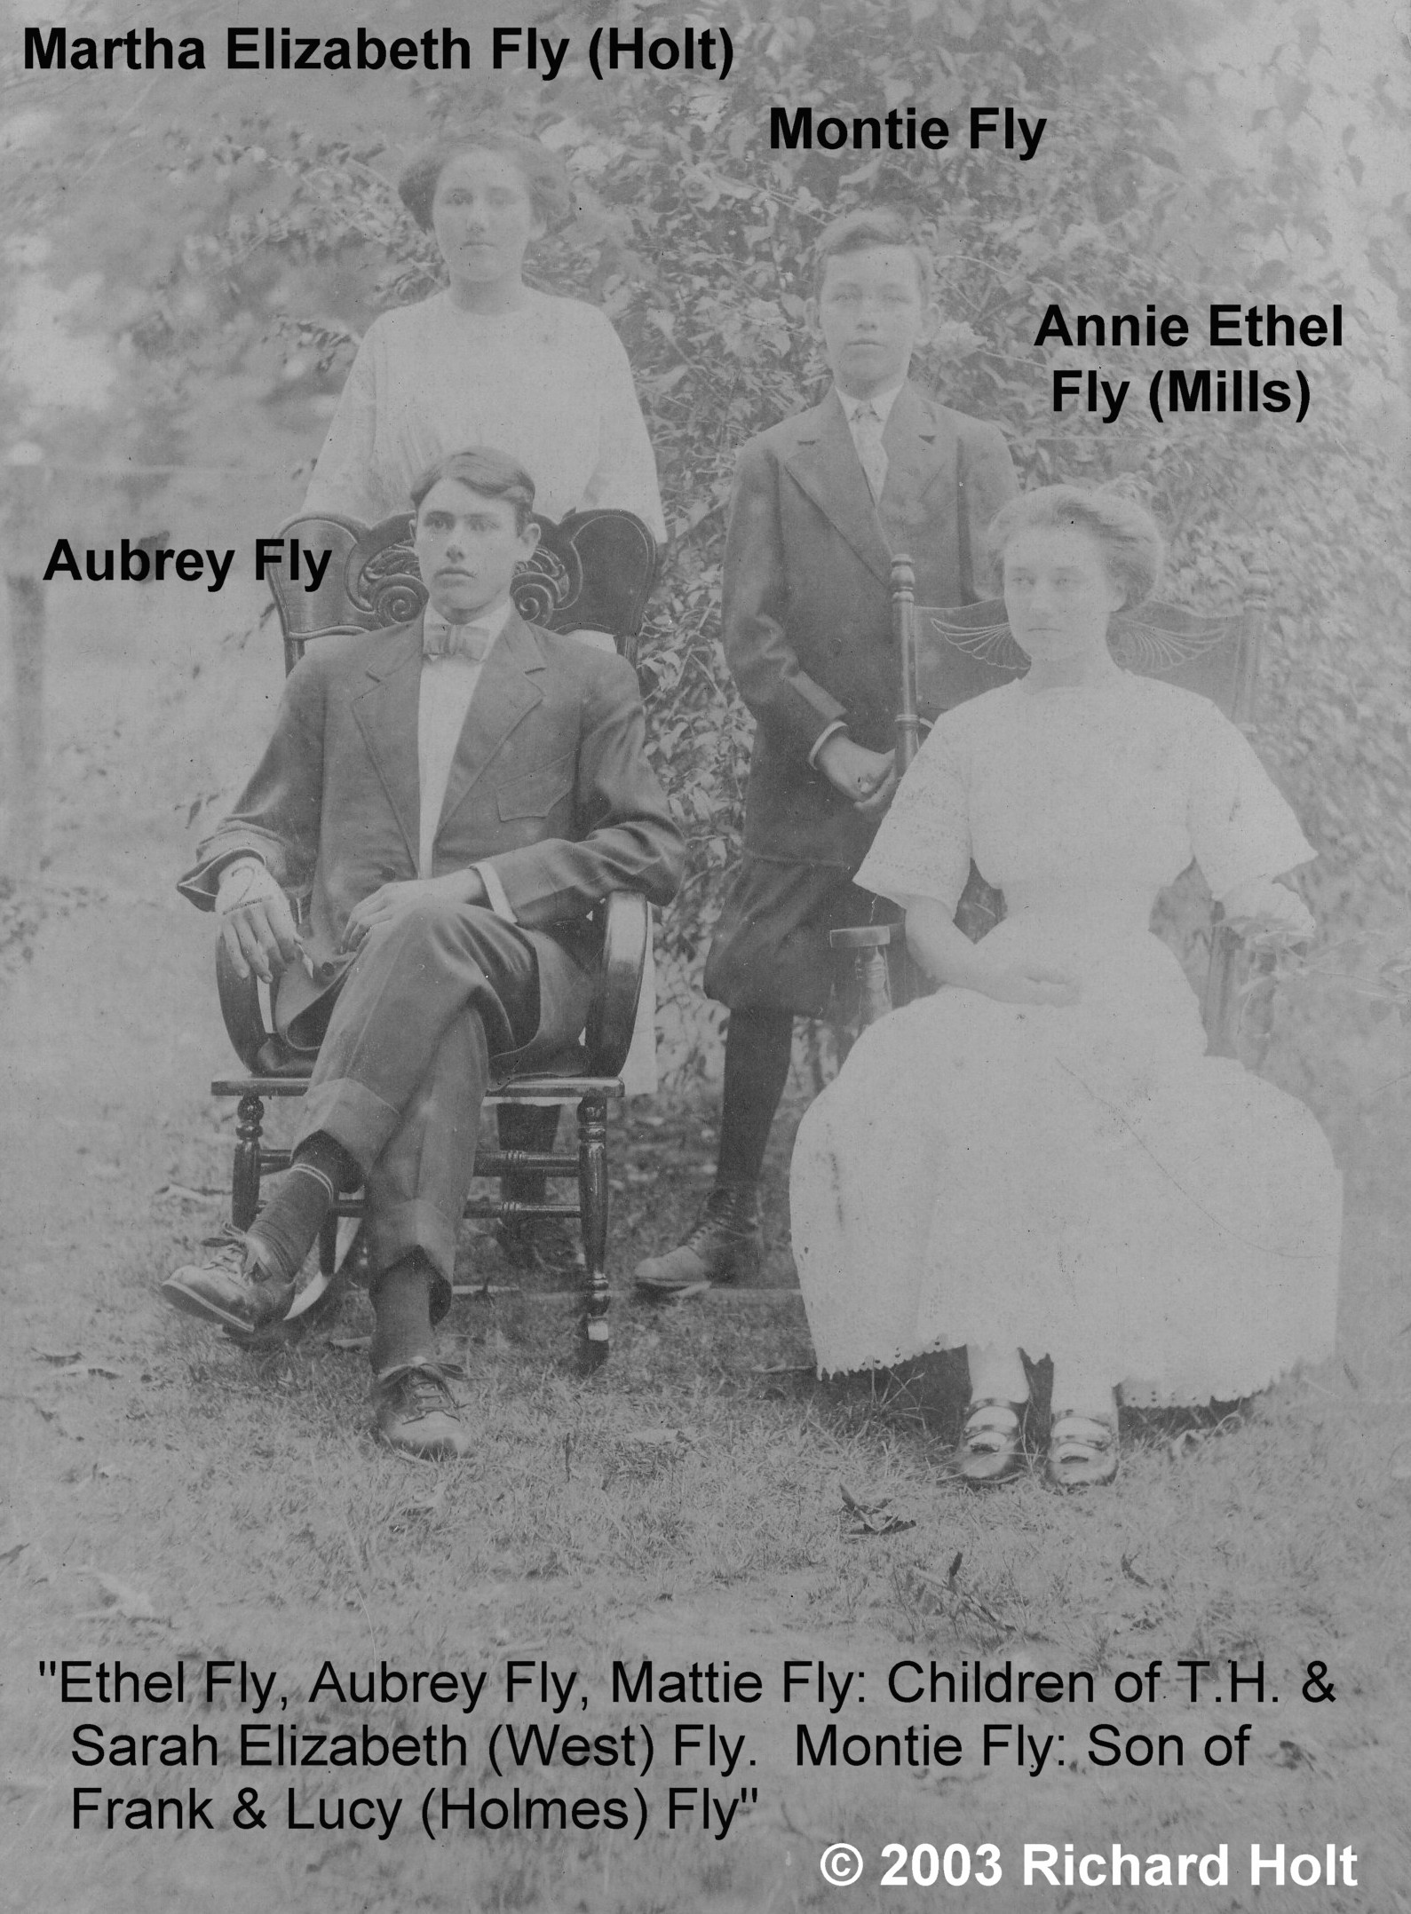
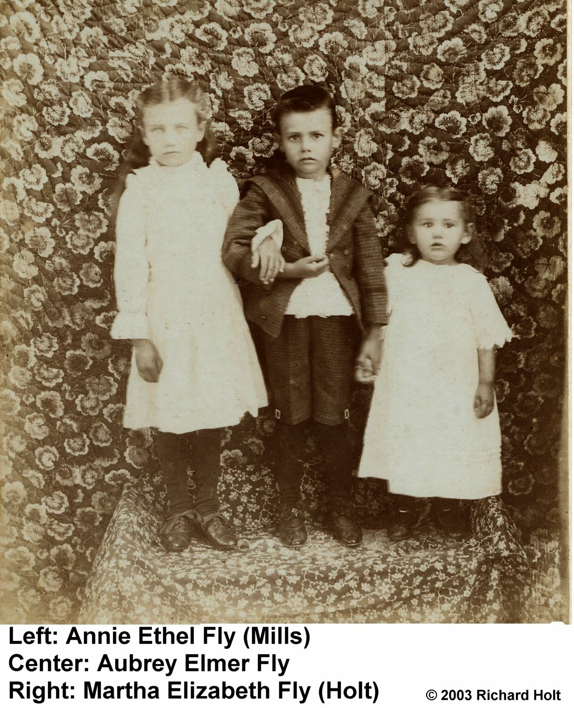
Children
Thomas and Sarah had 3 children:
Annie Ethel (Ethel) Fly born 1892 - died 1988
Aubrey Elmer Fly born 1894 – died 1966
Martha Elizabeth Fly (Mattie, our Danma) born 1897 – died 1988
8

Slide 9
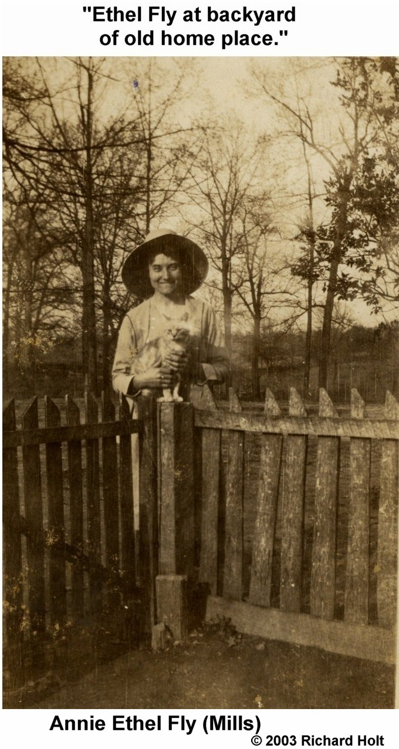
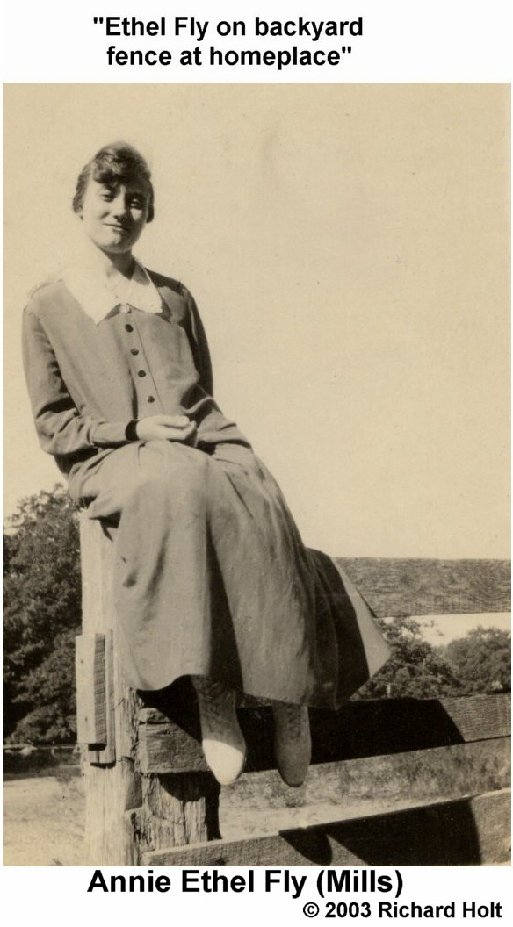
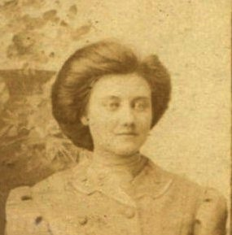
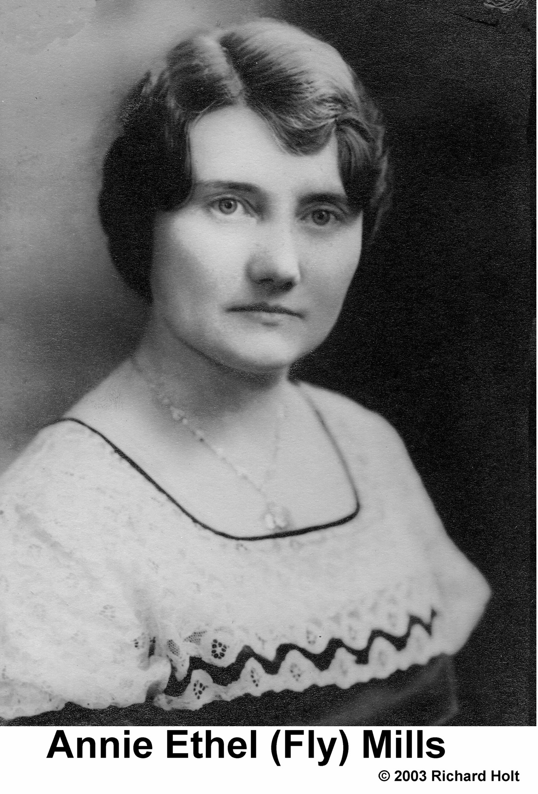
SISTER: Annie “Ethel” Fly
9

Slide 10
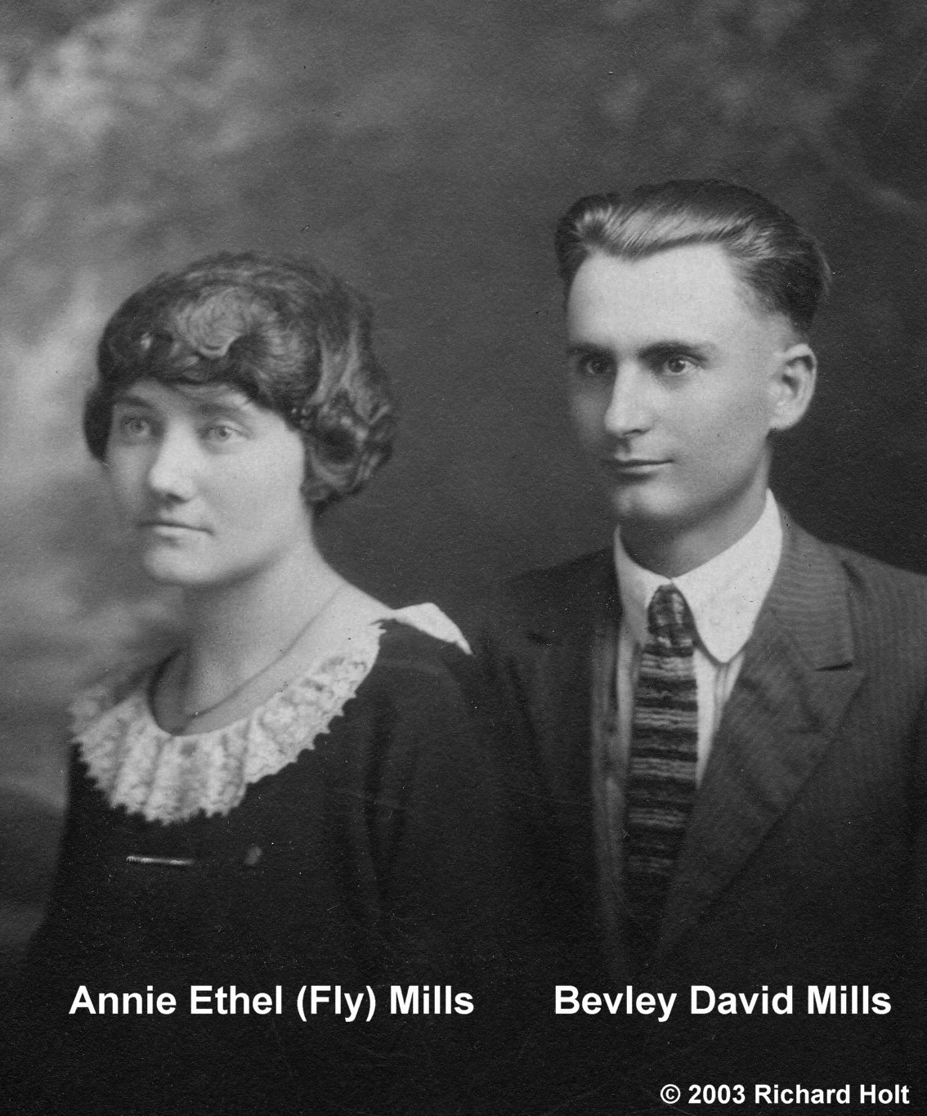
What we know about Ethel
Born 22 Nov 1892 in Milan, Gibson, Tennessee
School Teacher: Chapel Hill School was her 1st school, 1912
Married Bevley David (B.D.) Mills, “a promising young farmer” on 17 July 1917; the Officiant was G. A. West
B.D. registered for the WW1 draft 5 Jun 1917; left for France on the Brest with Danda in 1919; he caught tuberculosis
The Mills had one child, Sarah Frances
  Stillborn on 9 Apr 1921
  Unknown cousin maintained that Ethel was buried with her daughter’s layette
B.D. died 24 Aug 1924 in Medina of tuberculosis
Ethel, “a retired Gibson County school teacher”, died 19 Nov 1988 in Milan
The Mills family is buried at Hopewell Cemetery in Medina
10

Slide 11
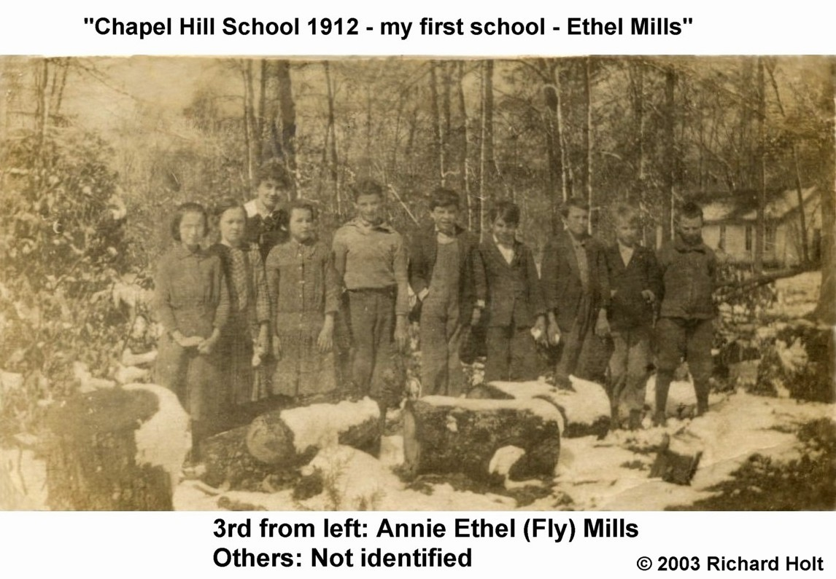
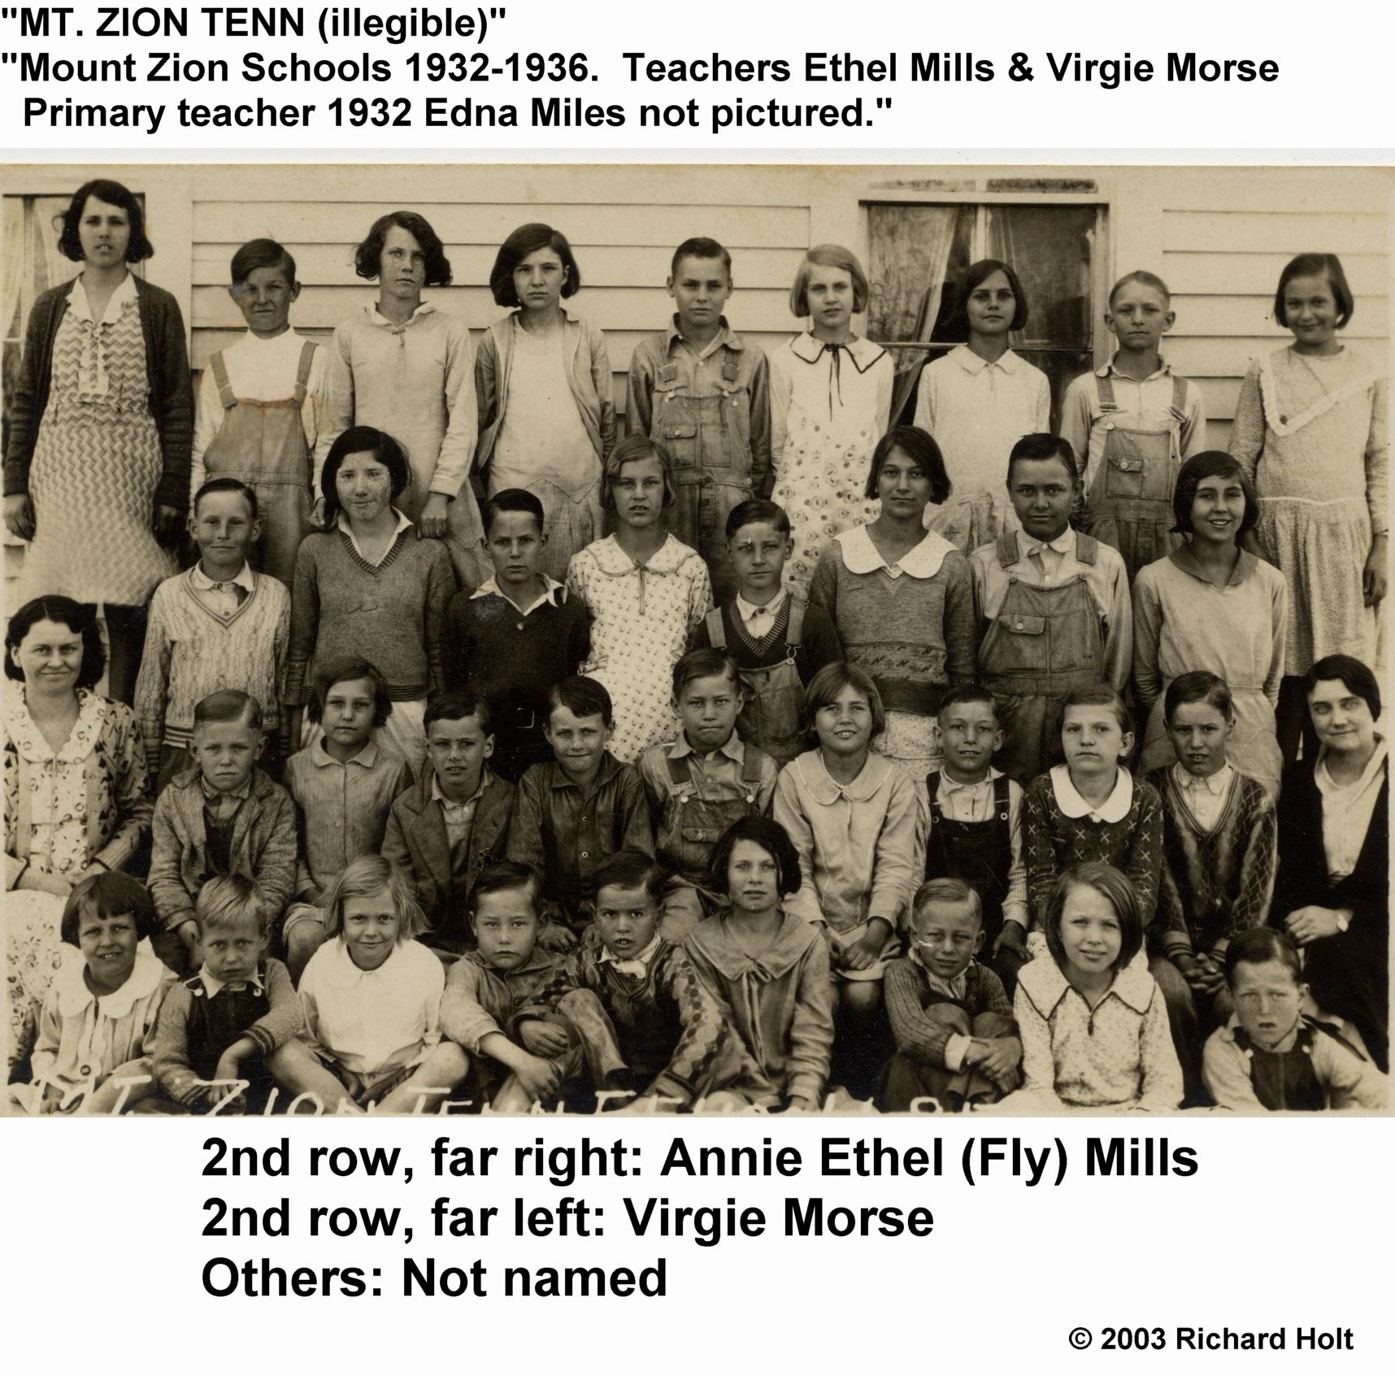
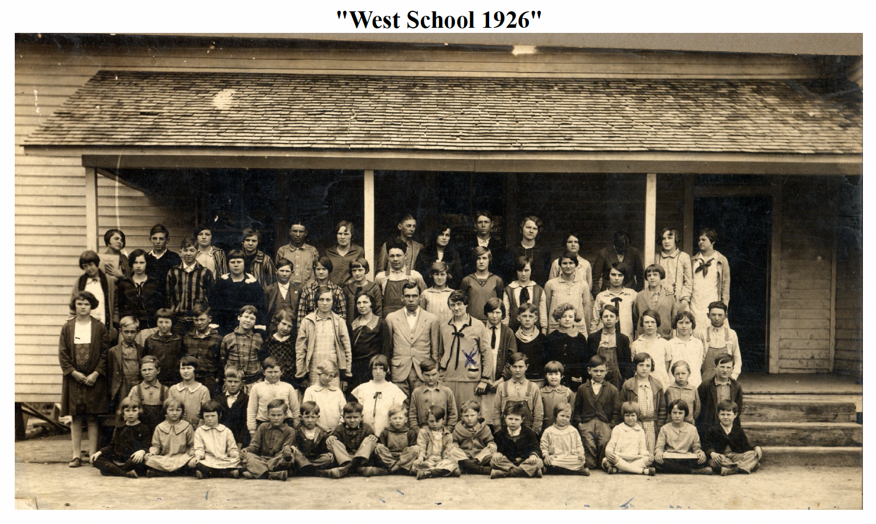
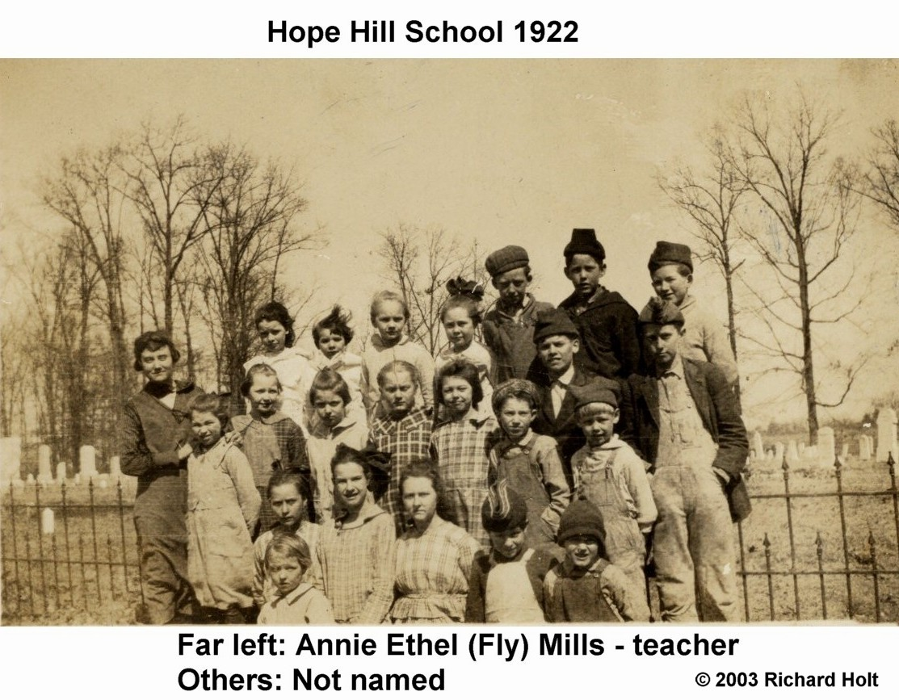
Schools
11

Slide 12
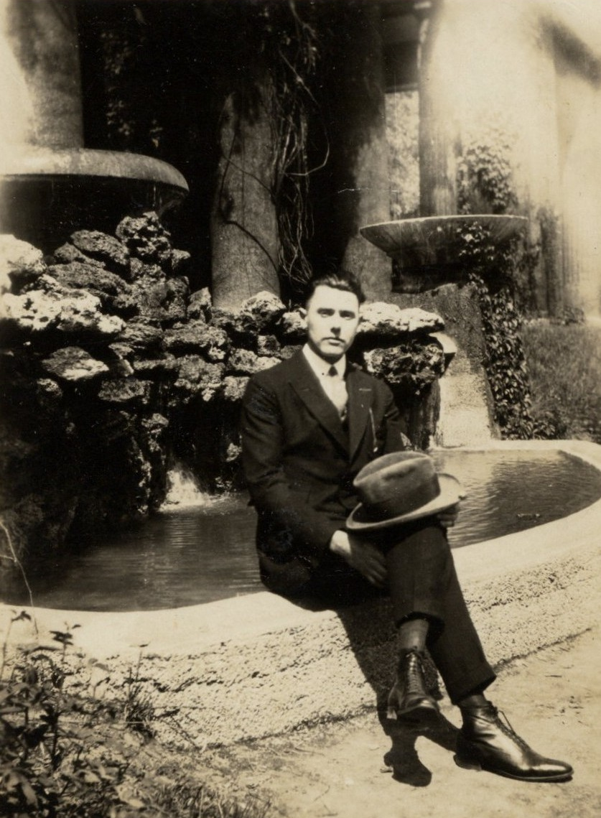
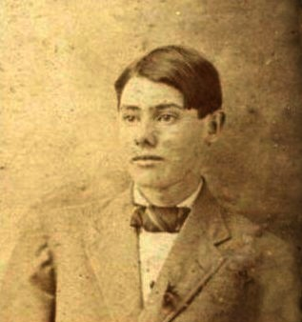
BROTHER: Aubrey Elmer Fly

Slide 13
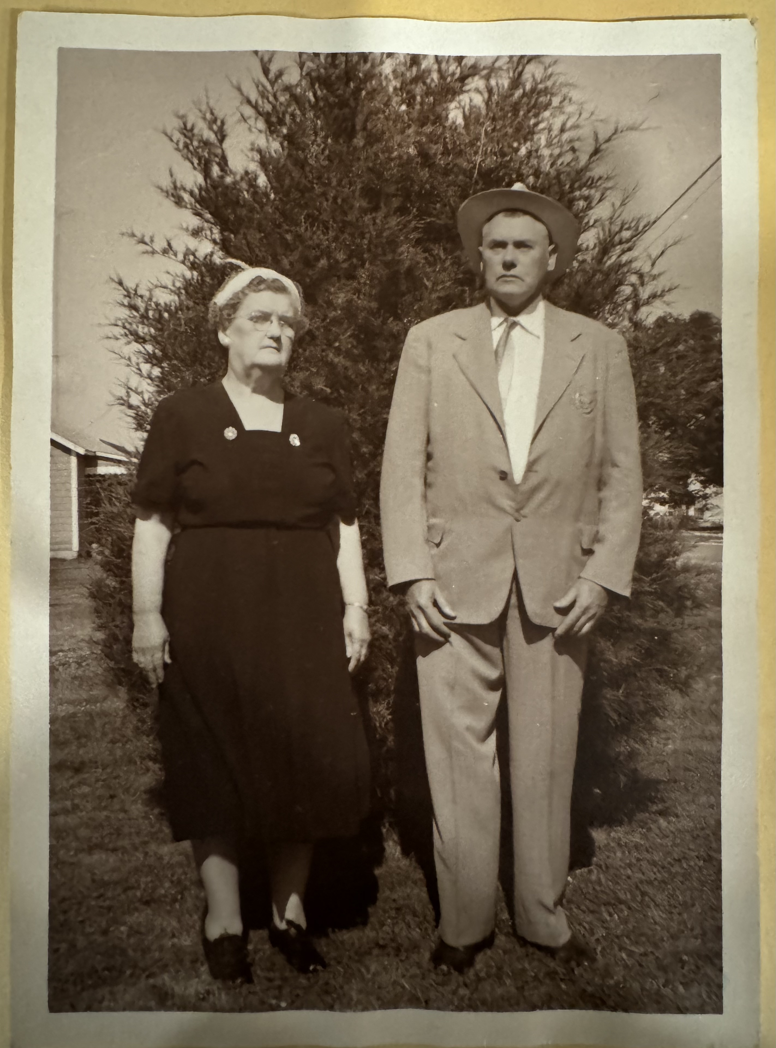
What we know about Aubrey
Born 30 Jan 1894 in Gibson County, TN
Aubrey, “a young farmer”, married Lela May Browning of Sitka, on 14 Aug 1913 in Gibson County, TN
Registered for the WW1 draft on 5 Jun 1917
  Medium tall, slender build, grey eyes, black hair
  Shipped out 1919 on The Hudson
1920 Census (Gibson County)
  Occupation: Farmer
  Aubrey was renting the land he worked
  Lived next door to parents
The Flys had 2 children: Lewis Early Fly and Bernice Marie Fly
From 1940s forward, the Flys were fruit dealers and grocery store retailers
Aubrey died 5 Jan 1966 of arteriosclerosis-related complications
Lela died 3 Oct 1973; she was living with her daughter in Alabama
The Flys are buried in Oakwood Cemetery in Milan
13

Slide 14
Aubrey’s Children
Lewis “Earl” Fly, 1924-1987
Bernice Marie Fly,1925-2010

Slide 15
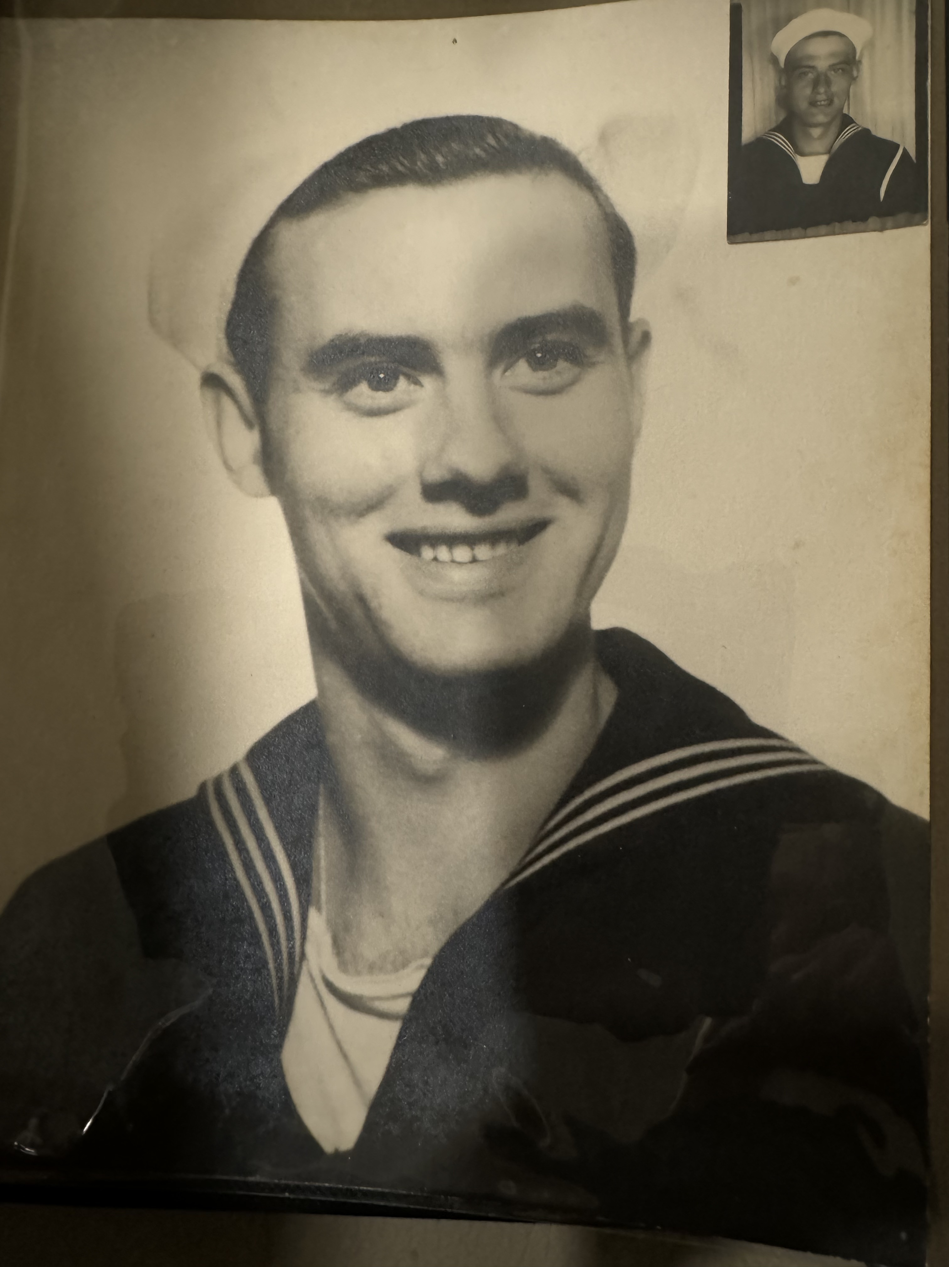
What we know about Earl Fly
Born 17 February 1924 in Milan, TN
Married Laverne Climer 29 October 1939
1940 Census: Married; Truck Driver
In 1942, registered for WWII draft
  5’10”, 145 lbs, gray eyes, black hair, light complexion
  Next of kin = Father; working for Irving Fly
The Flys had 2 children: Ron and Anne Marie
Earl and Laverne worked in Christian ministry for over 30 years
Earl was a licensed pilot
Earl died in 1987 in Jackson, TN
Laverne died in 2006 in Jackson, TN
Both are buried in Highland Memorial Gardens, Jackson, TN
15

Slide 16
Earl’s Children
Ron Earl Fly, 1951-2021
  Married Sybil Henson
  Died during COVID, wife died in 2023
  1 Son: Robert Earl Fly
  2 Grandchildren: David and Jessica Fly
  Owned outdoor advertising/sold it and opened a gallery in Gatlinburg

Slide 17
Earl’s Children
Anne Marie Fly, 1953
  Married to Bobby Coffman, 1991
  2 Daughters
    Bethany Anne Jones, 1975
      Married to Douglas DeAngelis
      Children: Jonas Heuer (24), Isabel Heuer (23), Sky DeAngelis (17), Elias Heuer(16), Felix Huer(15)
    Carla Marie Jones 1978
      Married to Christopher Wade Wyatt, 2000
      Both educators/coaches
      Children: Bond Aaron Wyatt (21), Brett Thomas Wyatt (18)

Slide 18
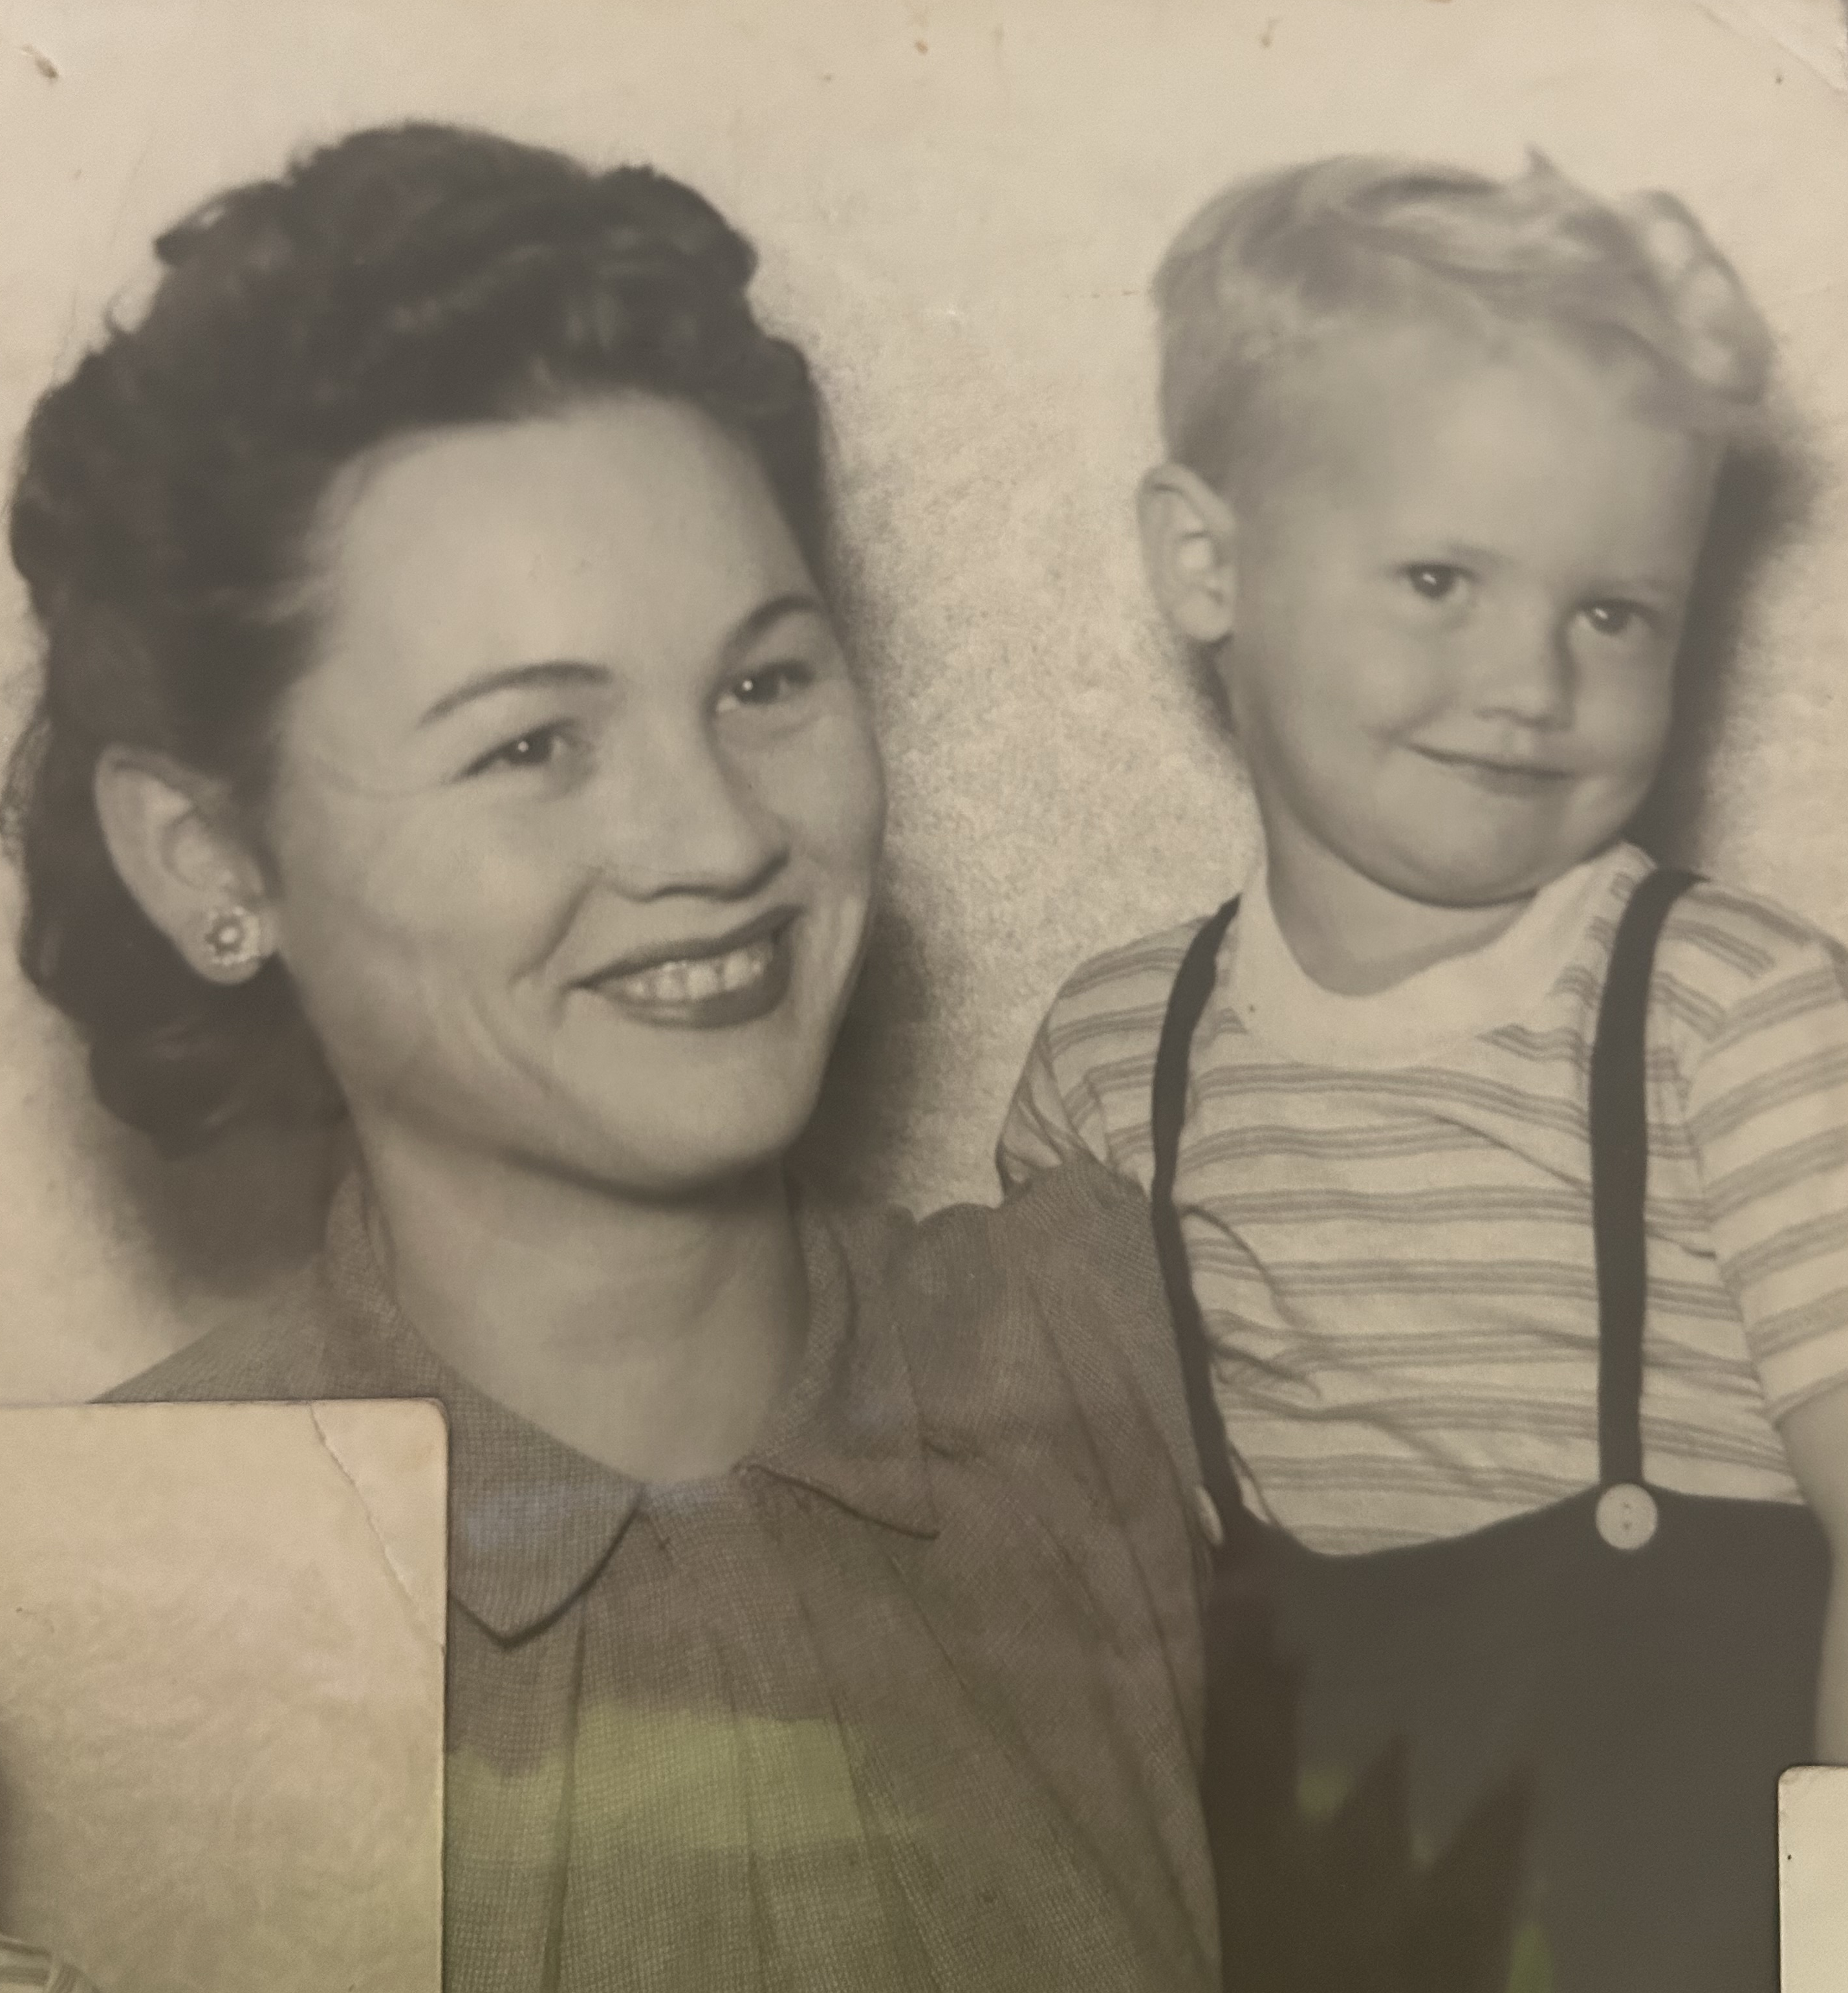
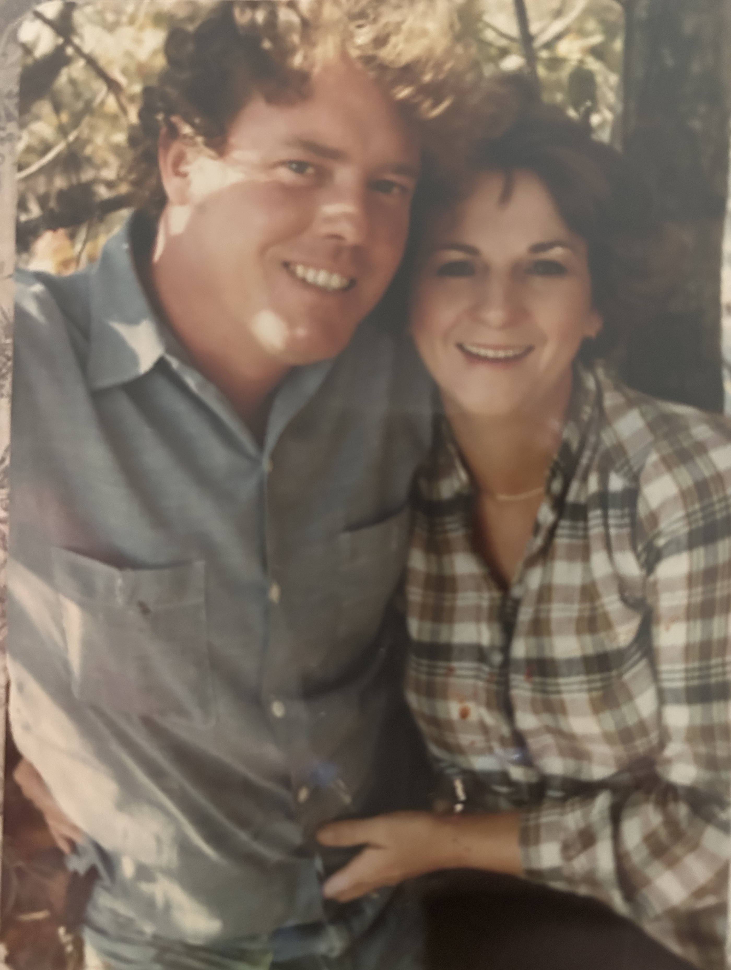
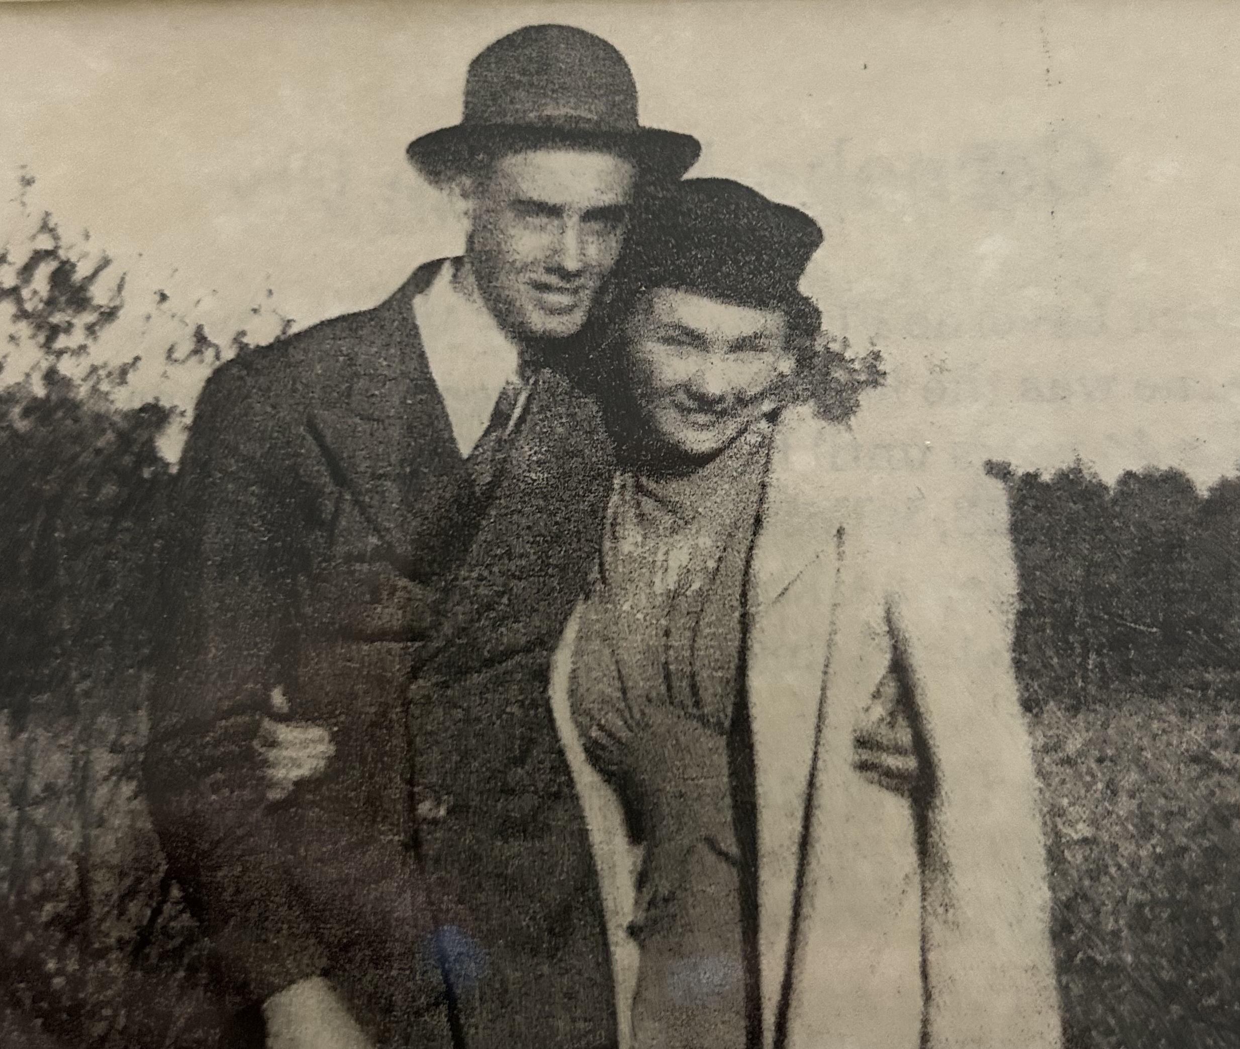
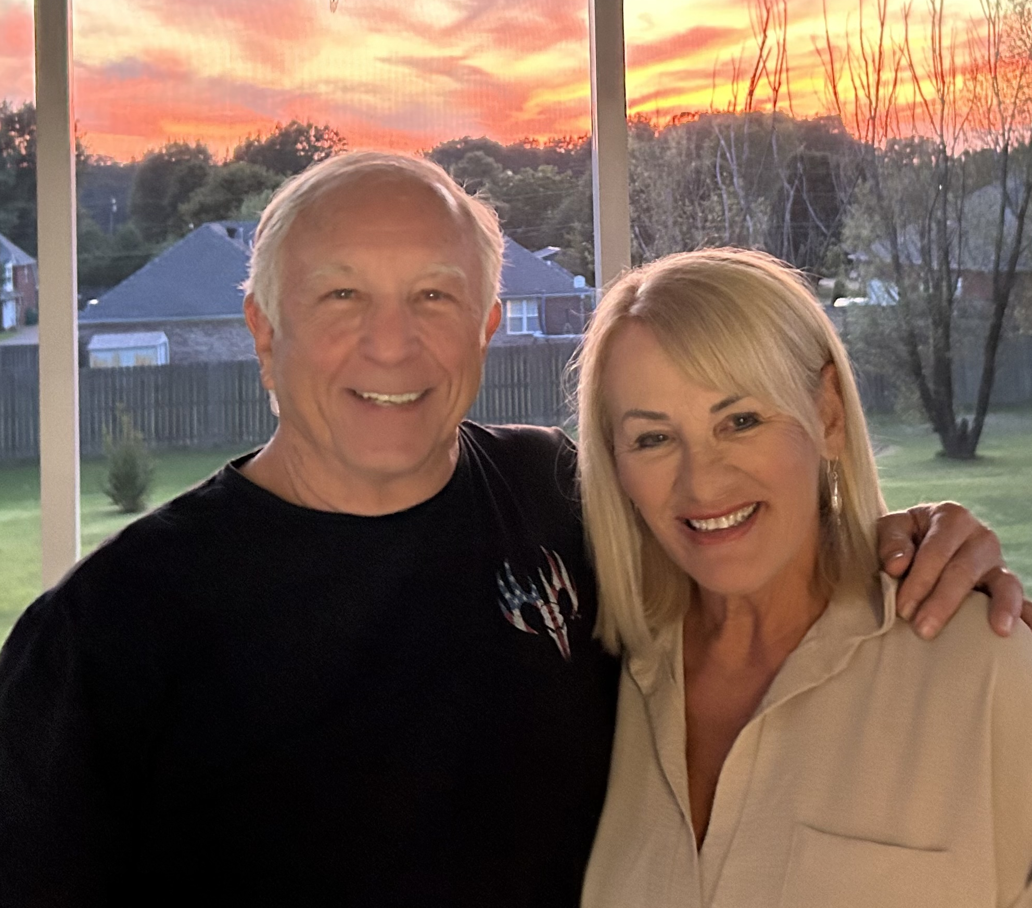
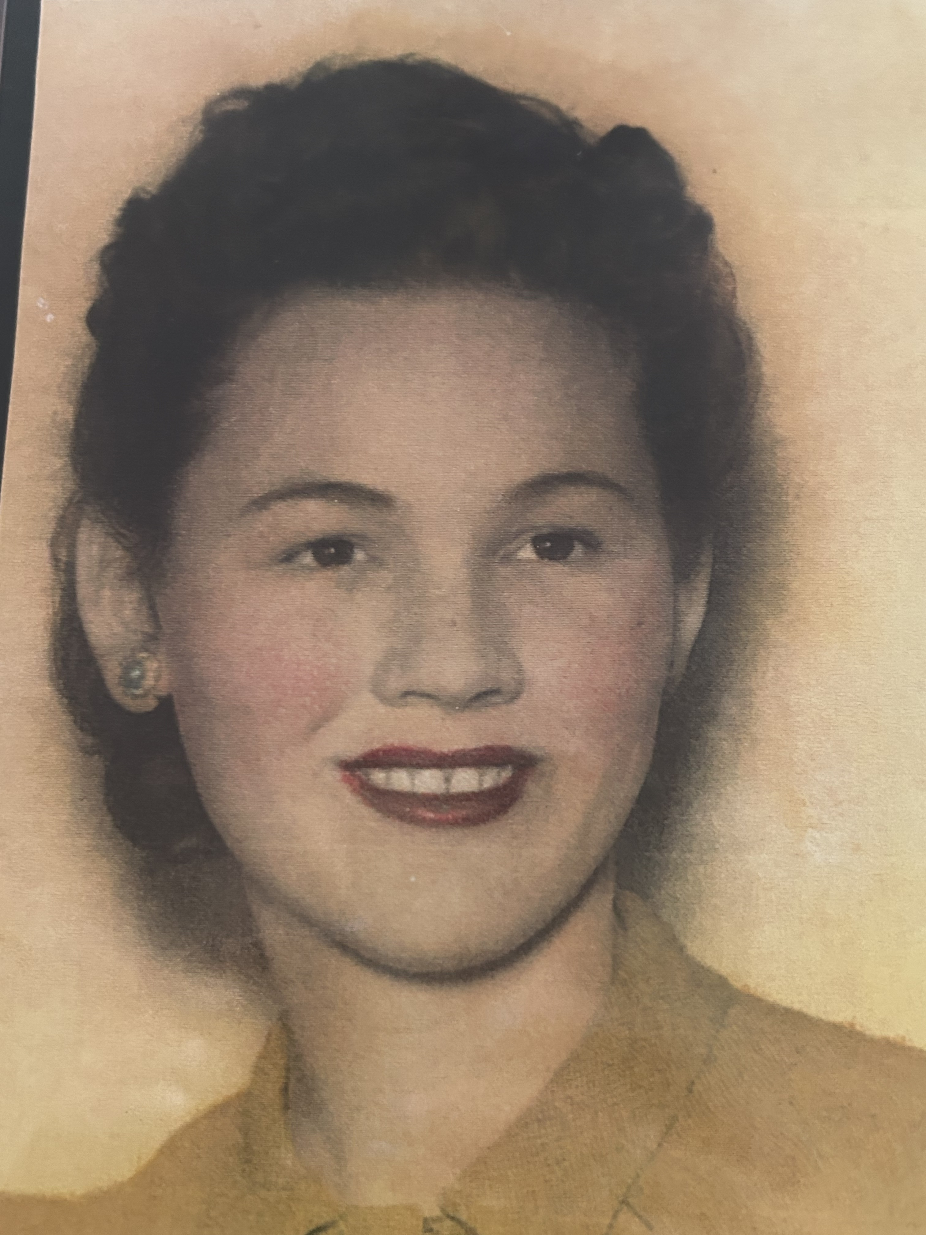
Earl Fly Family Photos
18

Slide 19
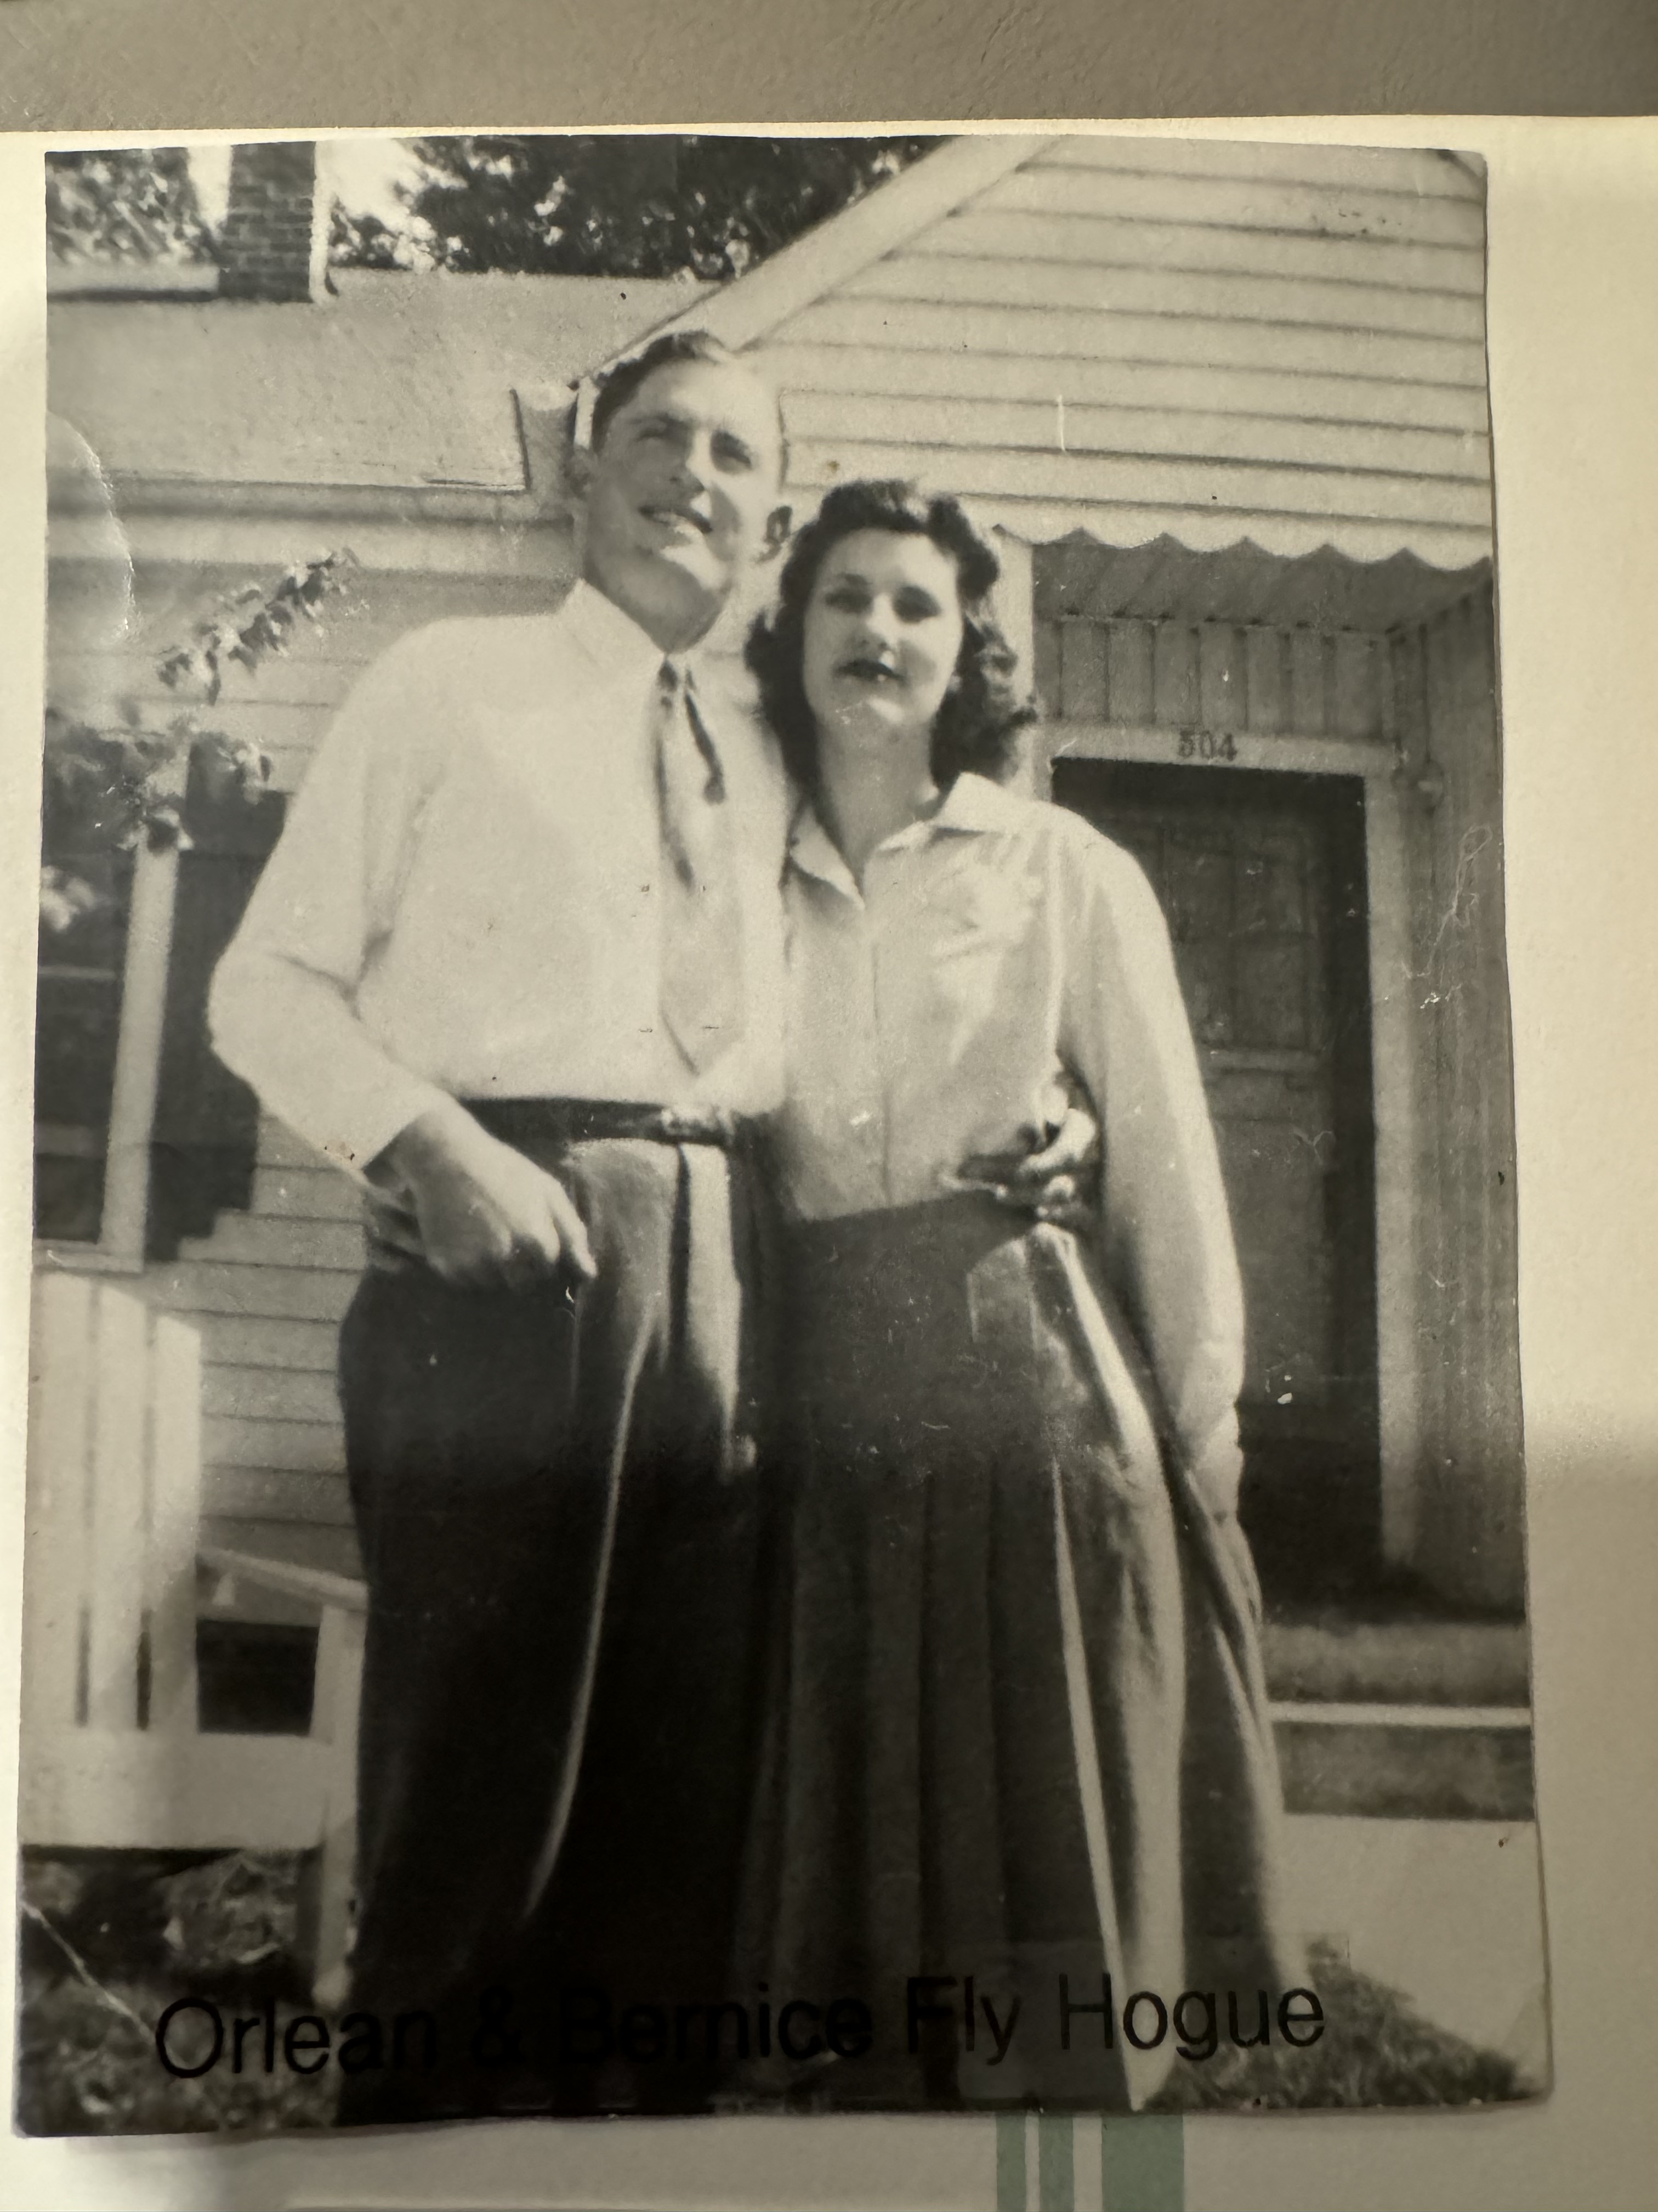
What we know about Bernice Fly
Born 10 October 1925 in Gibson County, TN
In 1946, Bernice married Orlan Herschel Hogue, a WWII veteran and a minister
The Hogues had 3 children – Jim, Philip, and Janis
Orlan served as the pastor of Huntingdon Church of Christ until his death
Orlan died 10 May 1956 when he fell and hit his head causing a cerebral hemorrhage
Bernice remarried Lawrence Clifton Darnell in 1969 and moved to Alabama returning to Tennessee before her death
Bernice died 29 December 2010
Both Bernice and Orlan are buried in Oakwood Cemetery, Milan, TN
19

Slide 20
Bernice’s Children
Jimmy Orlan Hogue, 1946-2002
Janis Hogue, 1952-2011
  Married James O. Ellis
Philip Hogue

